Slide 1
TOMATO

Slide 2
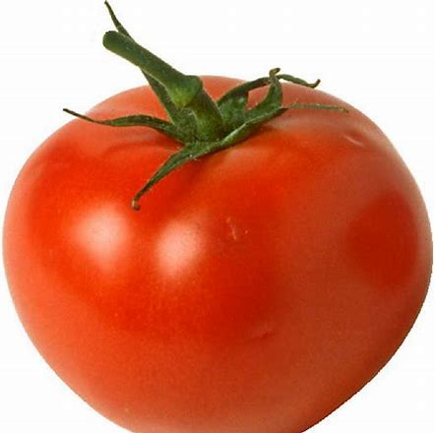
As a member of the nightshade family (along with aubergines, peppers and chillies), tomatoes are in fact a fruit, but their affinity for other savoury ingredients means that they are usually classed as a vegetable.

Slide 3
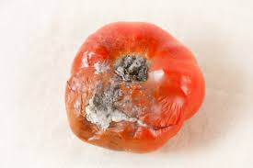
To avoid deterioration, tomato should be well stored

Slide 4
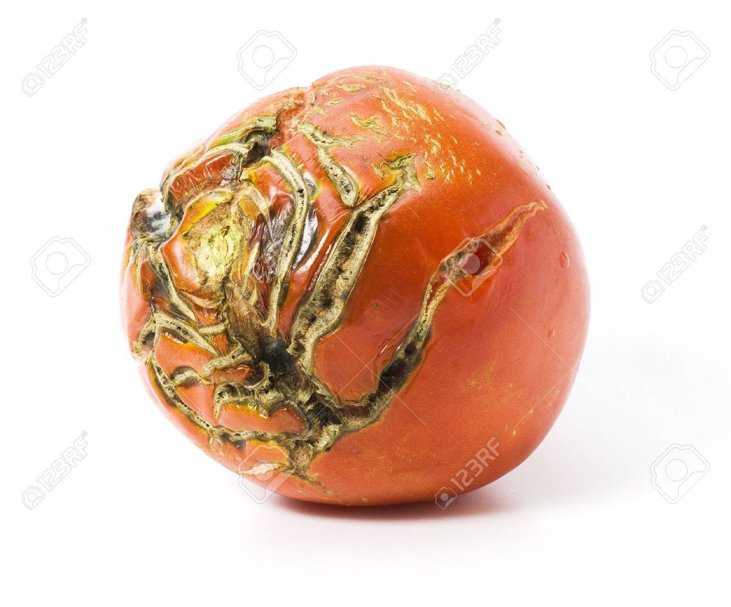
There are several poisonous substances in spoiled tomato such as mould and bacteria

Slide 5
There are several way to differentiate between good tomato and spoiled tomato

Slide 6
Before cooking tomato, you should check firstly whether the appearance of it is smooth without white mould, then you should smell to check whether the odour of it is sour or not, if it smells sour and putrefactive, it is spoiled one and you should not eat it.

